Slide 1
Deafness & Hearing Impairment: Orientation
1
1
Notes:
To begin with introduce theme to the terms ‘Deafness’ and ‘Hearing loss’.

Slide 2
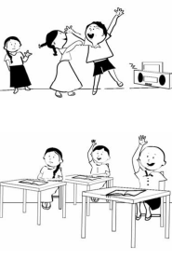
Deafness & Hearing Impairment
Hearing Impairment: Decrease in hearing sensitivity in one or both ears.
Deafness: Profound or total loss of hearing in both the ears.
Notes:
Explain that Hearing Impairment may be in one or both ears. If one ear is normal, it may not lead to any functional problem in the child or adult. However, if both ears are affected, it will create problems for both children and adults.
Deafness refers to the situation where the person has no significant hearing in either of the ears. This is highly debilitating.

Slide 3
What is the need for Prevention of Hearing loss & Deafness

Slide 4
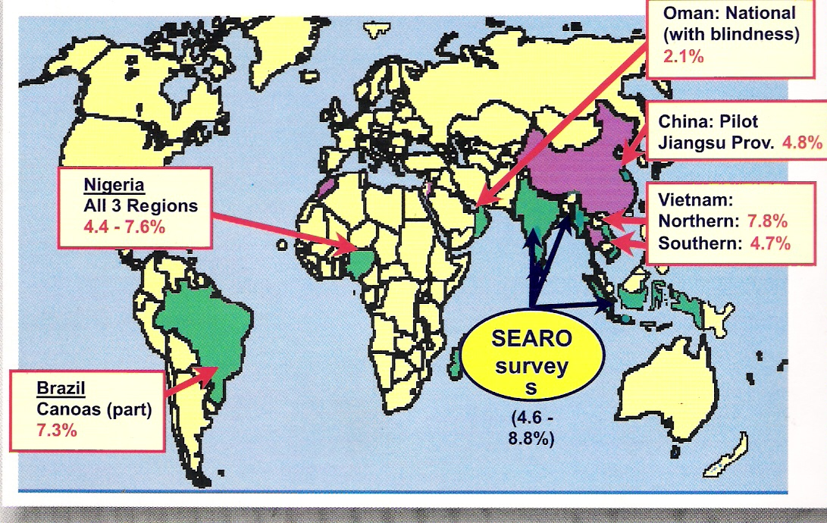
Globally…
All over the world, at least 278 million persons are affected by diseases of the ear & hearing problems that prevent them from being able to carry out their work & learning in a suitable manner.

Slide 5
South East Asia Region..
Over 101 million Hearing Impaired in SEA region.
38,000 Deaf children born every year in the region.

Slide 6
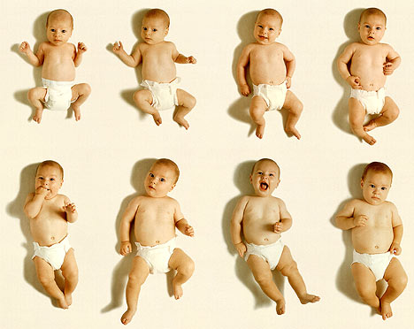

Deafness in Children
2 out of every 1000 live-born children suffer with Deafness
Such children are unable to hear.
They are therefore unable to learn language and acquire communication skills on their own.
Often, they fail to develop verbal language, are reluctant to go to school and are loosely to as ‘Deaf & Dumb’.
SH2030: Secondary Level Training Module.1
6
Notes:
Inform them that out of every 100 children born in the world, there may be 2 or more such babies that suffer with Deafness. we normally speak only what we hear. This is the reason that we learn our local languages. Whatever we hear from birth is what we gradually understand and learn to speak. If a baby is unable to hear anything, he will be unable to speak anything at all. He may make sounds and take out noises. This is because his vocal cords and speech system is absolutely normal. However, since he is unable to hear, he cannot speak any proper language. Such children are often called Deaf & Dumb. Such a term is improper and they will be able to speak if we help them..

Slide 7
What difference can we make
Such children have a chance to develop spoken language, if they are rehabilitated early with the use of Hearing Aids, hearing & speech therapy.
The earlier the rehabilitation is begun, the better are the results.
Rehabilitation MUST be started in the first year of life.
Our role is to find such children & ensure their treatment
7
Notes:
Stress to the trainees that they can prevent many cases of hearing loss and deafness by helping to create awareness regarding the preventable causes of deafness. They can make a major difference to the lives of many deaf children by detecting them early and convincing their parents to start suitable treatment with hearing aids and therapy at the district hospital so that they can be rehabilitated at an early age and can lead a normal and productive life.

Slide 8
Children with milder forms of hearing loss
They suffer from ear diseases such as Discharging ear.
A large percentage can be prevented by suitable measures.
Most cases are treatable
If not detected & treated early, they can lead to:
  Life threatening complications
  When bilateral: poor language development
  Poor academic performance
Notes:
Stress to the trainees that the children with milder forms of hearing loss and ear diseases such as CSOM, OME etc. If they remain undetected, that can lead not only to hearing loss and poor language skills but can also cause life threatening situations, at times.

Slide 9
Facts:
50% of the Hearing loss is PREVENTABLE!
80% can be rehabilitated with proper modalities of intervention
Notes:
Taking note of the high prevalence of hearing loss and deafness as well as the fact that over 50% of deafness and hearing can be prevented, WHO initiated regional efforts to develop a forum for Prevention of Deafness & Hearing loss. This lead to the launch of Sound Hearing 2030 in 2005. It is also a fact that of those who suffer with hearing loss, over 80% can be benefitted through medical, surgocal and rehabilitative interventions.

Slide 10
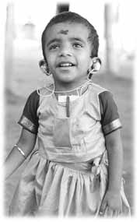
VISION
To improve the quality of life in the Asian Region by including the RIGHT TO BETTER HEARING, in developmental programs of the target countries .
10

Slide 11
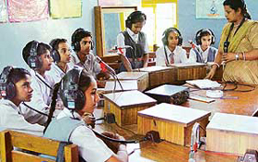
MISSION
To eliminate avoidable hearing impairment by the year 2030 through development of sustainable and inclusive ear and hearing care systems.
11
Notes:
The picture depicts the use of inclusive ear and hearing care system to provide education to the hearing impaired students. It shows a classroom with a teacher and students sitting around a circular table. The students are using headphones. The teacher is wearing a microphone around her neck.

Slide 12
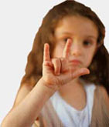
GOAL
To reduce avoidable hearing impairment in THE REGION to 50% by 2015 and 90% by 2030
12

Slide 13
Objectives
Through training, we wish to create awareness amongst health care workers regarding:
  Preventable aspects of ear diseases & hearing loss
  Good ear & Hearing care practices
  Enable the health workers to identify ear diseases & hearing loss in the community.
  Enable the health workers to provide suitable guidance to the patients/parents regarding management of the ear or hearing problem.
  Give specific targets to the health care personnel regarding their role in preventing & detecting ear diseases & hearing loss.
13
Notes:
Inform the participants that the objectives for the current training are to motivate the workers and sensitize them regarding:
Preventable aspects of ear diseases & hearing loss
Good ear & Hearing care practices
Also, to give specific targets to the health care personnel regarding their role in preventing, detecting & treating ear diseases & hearing loss.

Slide 14
Outline of the Training
Orientation*
Structure of Ear & Causes of Hearing Loss
Detection of Ear Diseases (in 2 parts)
Identification of Hearing Loss
Care of the Ears & the Hearing Impaired child
Definition of Role &Messages for the community
14

Slide 15

‘The ultimate aim is to ensure that no person remains needlessly deaf or suffers the consequences thereof.’
Thank You.
SH2030: Secondary Level Training Module.1
15

